Slide 1
Lecture No. 41
At the end of this lecture, students will be able to:
Explain preparation of some important polymers
Discuss the mechanism and applications of conducting polymers

Slide 2
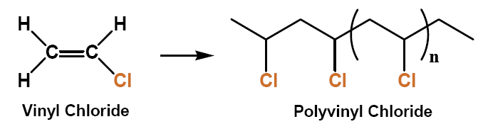
Polyvinyl chloride
PVC has high hardness and mechanical properties
Heat stability of raw PVC is very poor, so the addition of a heat stabilizer during the process is necessary
Good insulation properties
Has good flame retardancy
Used for sewerage pipes and other pipe applications,
As wire insulator
In construction and automobile industry

Slide 3
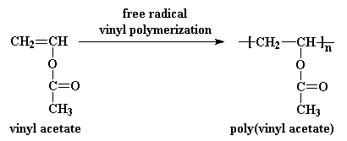
Polyvinyl acetate (PVA)
The degree of polymerization of poly(vinyl acetate) is typically 100 to 5000 while its ester groups are sensitive to base hydrolysis and will slowly convert PVAc into polyvinyl alcohol and acetic acid
A number of microorganisms can degrade polyvinyl acetate
Referred to as wood glue, white glue, carpenter's glue, school glue
Used as "white glue" and the yellow as "carpenter's glue“, paper adhesive

Slide 4

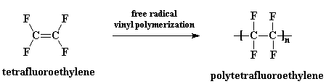
Teflon (Polytetrafluroethylene)
It is an addition polymer
Teflon is the trade name of poly tetra fluro ethylene
The monomers tetra fluro ethylene
Prepared by emulsion polymerization method using ammonium persulfate as initiators under pressure

Slide 5
Teflon
Properties:
It has density about 2.3 gram/cm3
It has high melting point 320⁰ C
It has nonstick property & slippery over wide range of temperature.
It has got good electric insulating property
Uses:
It is used for insulating motors, cables, and generators transformers,
capacitors
Used for nonstick cooking utensils
Used for gaskets, belts pump and valves packing etc.
Used as a dry lubricant
Good resistance to chemical

Slide 6
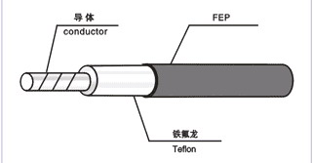
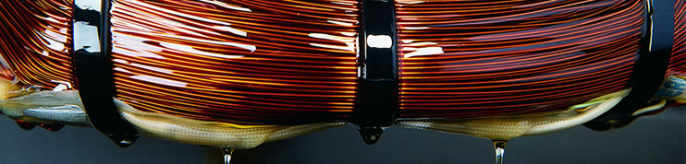
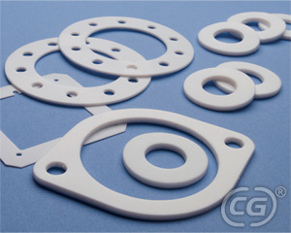
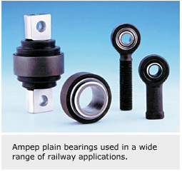
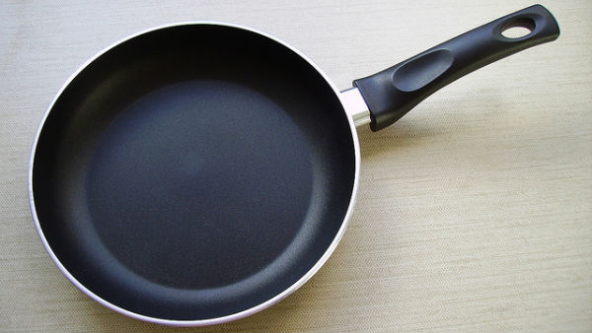
Applications
PTFE is used for wire and cable insulation, insulation for motors, generators, in the manufacture of seals and gaskets and in non stick cookware. It is used in bearings and pads for railway bogies, as an insulator in high voltage power transmission

Slide 7
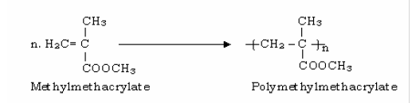
Polymethylmethacrylate (Plexi glass)
It is also an addition polymer
Plexi glass is the trade name of polymethyl methacrylate
Monomers used is methyl methacrylate
It prepared by emulsion polymerization method at 60 to 70ºc in presence of trace of H₂O₂ or Acetyl peroxide as initiator

Slide 8
Polymethylmethacrylate (Plexi glass)
Properties:
Plexi glass is a white transparent thermoplastic
It has got high optical clarity
It is resistant to chemical action
Applications:
i. It is used in the preparation of aircraft windows
ii. Attractive sign boards.
iii. Manufacturing of transparent moulded articles & tubes.
iv. Lenses for automobiles, artificial eyes etc.,

Slide 9
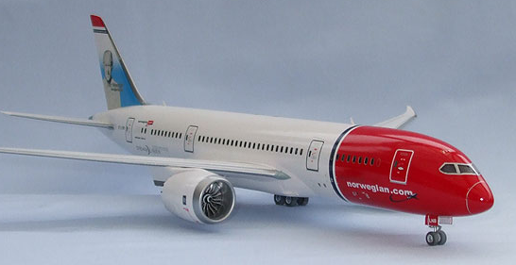
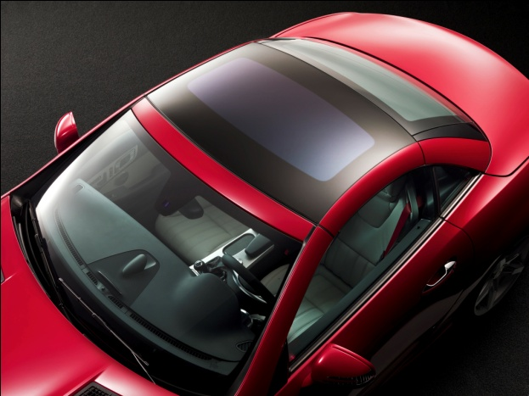
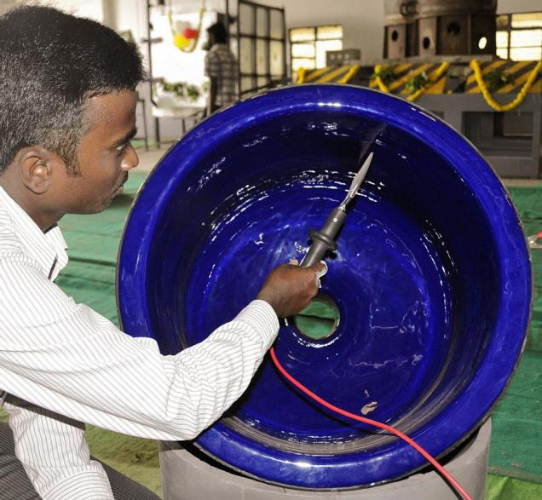
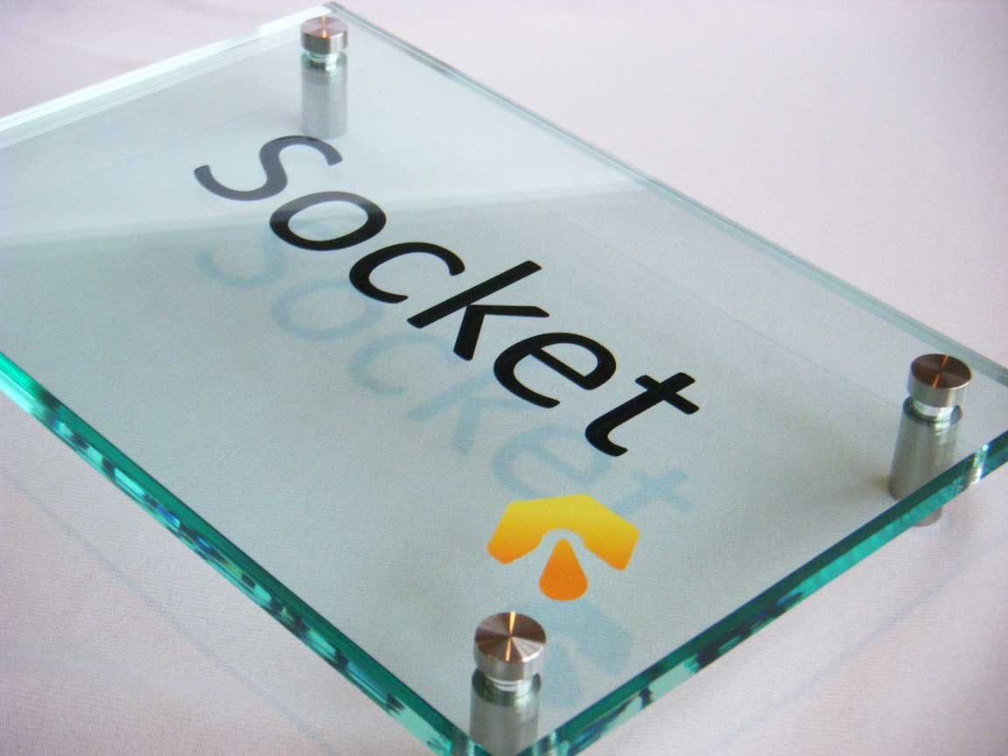
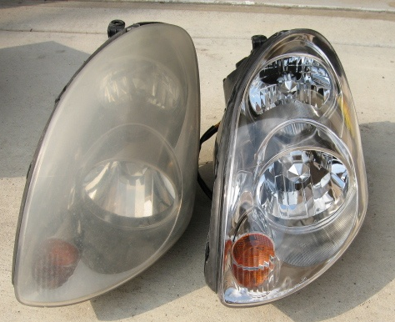
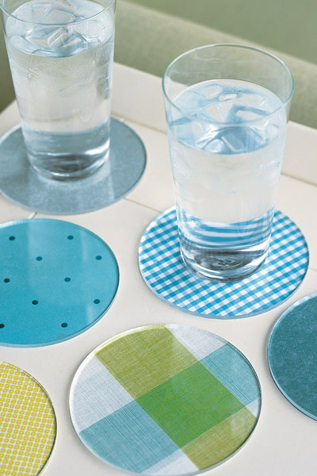
Polymethyl methacrylate
Applications: Glazing airplanes and automobiles, in the chemical equipments (as lining material), sign boards, lenses for automobile lighting, and domestic appliances

Slide 10
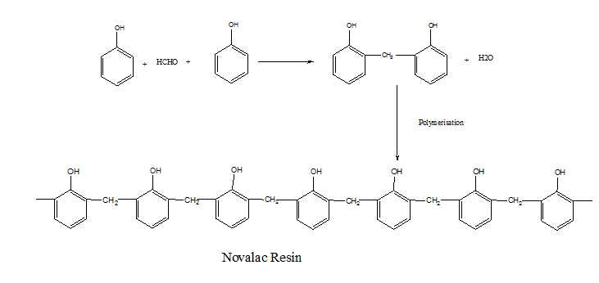
Phenol formaldehyde
It is an condensation polymerization
Monomers are phenol and formaldehyde
Commercially these are available into two forms novalac resin & resols resin

Slide 11
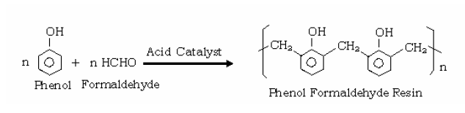
Novalac
These are phenol formaldehyde resins obtained by condensation of phenol & formaldehyde in presence of acid as catalyst when phenol to formaldehyde ratio is greater than one (Phenol is more)
Properties:
Novalac are linear polymers.
These have got good electric insulating property
Uses:
Used for sealing metal holders to the glass bulbs.
Bounding sheets of paper, wood, card boards etc

Slide 12
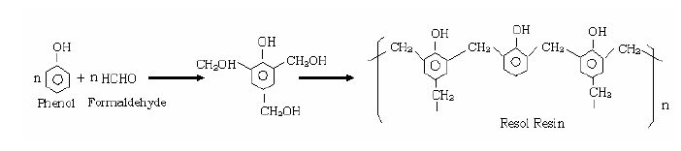
Phenol formaldehyde
Resol Resins
These are phenol formaldehyde resins obtained by the condensation of phenol & formaldehyde
In presence of alkali as catalyst
when phenol to formaldehyde ratio is less than one(Phenol is less)

Slide 13
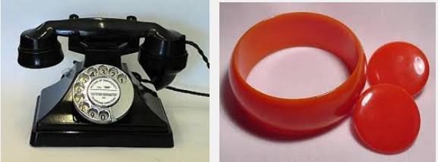
Phenol formaldehyde
Properties.
These are cross linked polymers
These are non conductor of electricity
Resols can be converted into bakelite by adding additives such as wood, dies etc.,
Uses.
Resol in the form of bakelite is used for the preparation of electrical fittings such as switches plugs, sockets, etc.
It is also used for preparing telephone out parts etc.

Slide 14
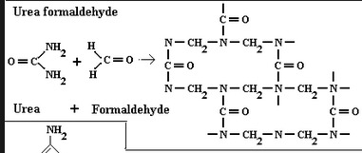
Urea Formaldehyde
High tensile strength, flexural modulus, high heat distortion temperature, low water absorption, mould shrinkage, high surface hardness, elongation at break, and volume resistance
Non-transparent thermosetting resin or plastic, made from urea and formaldehyde heated in the presence of a base
Used in adhesives, finishes, particle/chip board, medium density fiber board, and molded objects
Decorative laminates, textiles, paper, foundry sand molds, wrinkle resistant fabrics, cotton blends, etc.

Slide 15
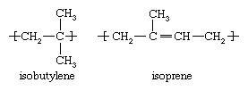
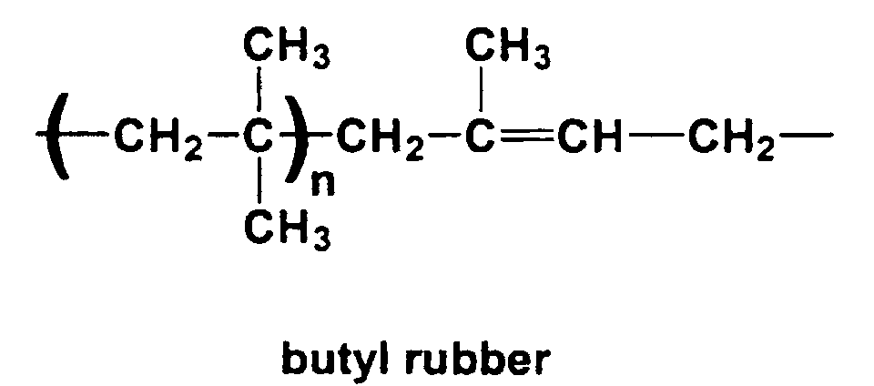
Preparation, Properties and Applications
Elastomers:
Elastomer is defined as “a long chain polymer which under stress undergoes elongation by several times and regains its original shape when the stress is fully released”
Isobutylene is mixed with 1.5 to 4.5 % of isoprene
Reaction mixture is cooled to -95°C and stirred thoroughly with anhydrous Aluminium chloride in methyl chloride

Slide 16
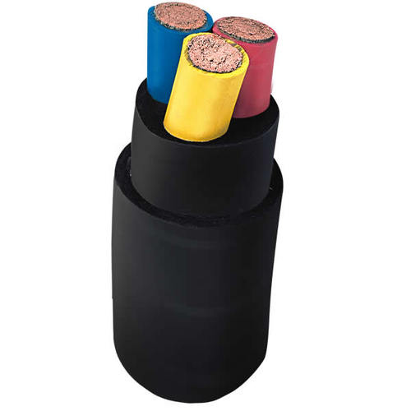
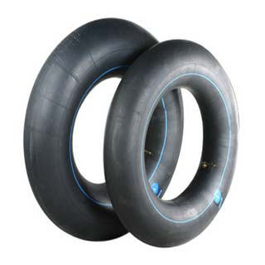
Properties and Applications
Good resistance to heat, abrasion, and to chemicals.
Exhibits low gas permeability
Applications: Inner tubes for tyres, for insulation of high voltage wires and cables

Slide 17
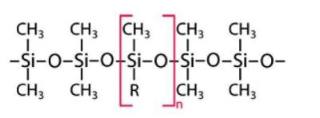
Preparation, Properties and Applications
Silicone Rubbers:
n Si(CH₃)₂Cl₂ + n H₂O → [Si(CH₃)₂O]_{n} + 2n HCl
Properties: Generally non-reactive, stable, and resistant to extreme environments and temperatures from -55°C to +300°C while still maintaining its useful properties

Slide 18
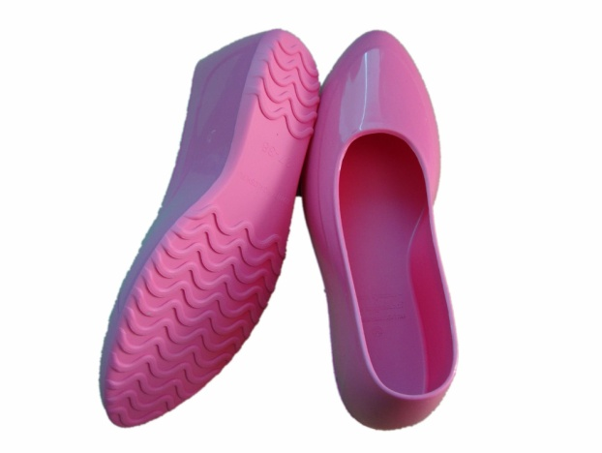
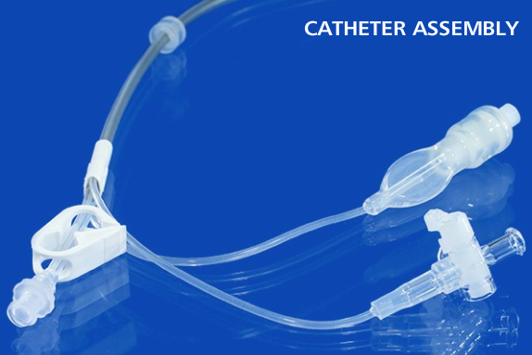
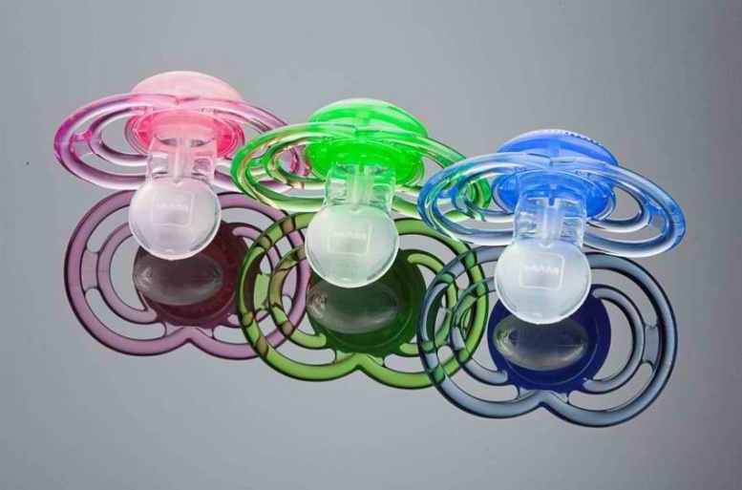
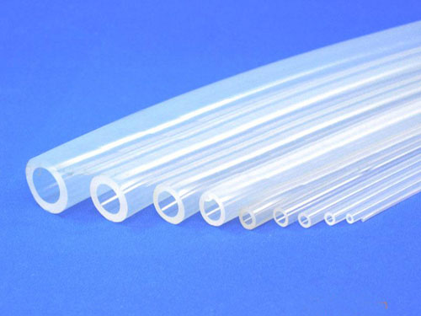
Applications
Automotive applications
Cooking, baking, and food storage products
Apparel such as, sportswear, and footwear
Electronics; medical devices and implants;
Silicone sealants

Slide 19
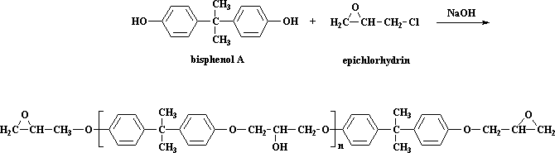
Preparation, Properties and Applications of Epoxy
Adhesive:
Epoxy -

Slide 20
Properties
Epoxy group at both the ends of the polymer chain
Linear, low molecular weight polymers soluble in organic liquids and highly resistant to acids, alkalies and abrassion
Good adhesion capacity and can be used for binding various surfaces – rubber, wood, leather, ceramics, metals and polymers
Good electrical insulating property

Slide 21
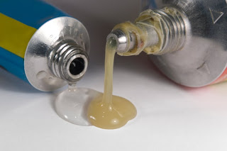
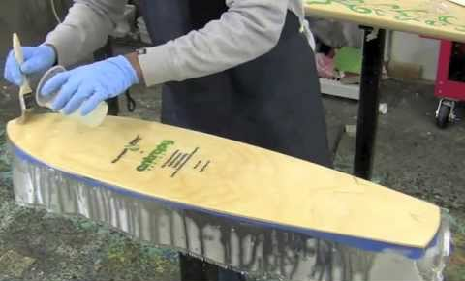
Applications
Used as structural adhesives
In laminating the materials
Used to impart shrinkage resistance in fabrics

Slide 22
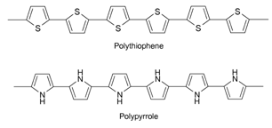
Conducting Polymers
Organic polymers with highly delocalized Pi electron (Π) system having electrical conductance of the order of a conductor
Organic polymers having conjugated double and single bond alternatively when doped with oxidizing or reducing agents conducts electricity are called as conducting polymers
Examples: Conjugated polymers such as polypyrrole, polythiophene, polyaniline, etc.

Slide 23
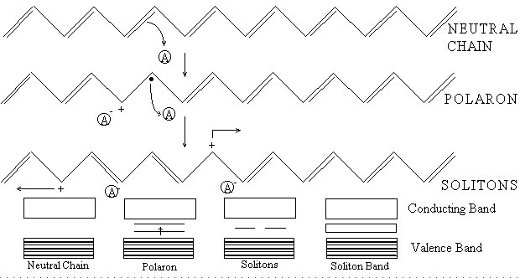
Mechanism of conduction in Polyacetylene

Slide 24
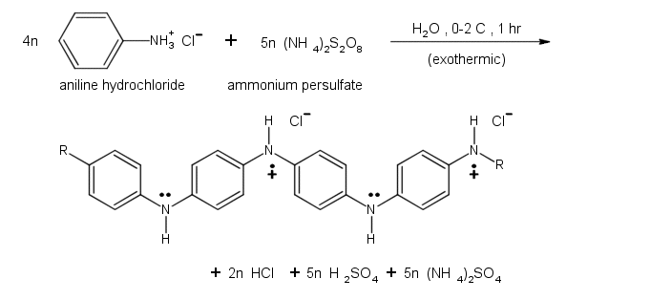
Synthesis of polyaniline

Slide 25
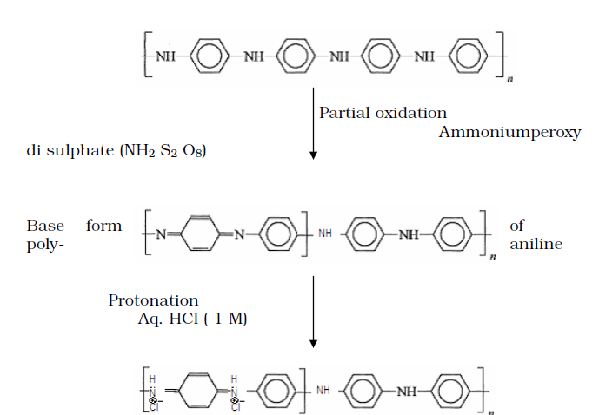
Synthesis of Polyaniline

Slide 26
Applications of Conducting Polymers
Organic solar cells,
Printing electronic circuits,
Organic light-emitting diodes,
Actuators,
Supercapacitors,
Chemical sensors and biosensors,
Flexible transparent displays,
Electromagnetic shielding
Microwave-absorbent coatings, particularly radar-absorptive coatings on stealth aircraft

Slide 27
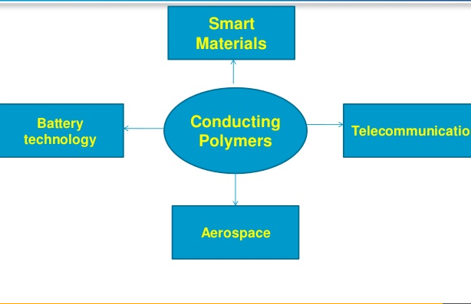
Conducting Polymers

Slide 28
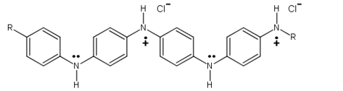
Summary
Preparation of some important polymers

